Slide 1
Decentring Collective Action
Collective Agency and Internet Activism in China
Yingqin Zheng, yzheng@dmu.ac.uk
Centre of Computing and Social Responsibility
De Montfort University, Leicester, UK
Cheng Zhang, zhangche@fudan.edu.cn
Fudan Universtiy, Shanghai, China

Slide 2
Internet Activism As
Virtual Collective Action
“New media power” (Bennett 2003)
  “Battle for Seattle” 1999
  Arabic Spring 2010-2011
The role of ICT in virtual collective action
  Lowering participation threshold
  Distributed intelligence
  Blurring the boundary between public & private good
  Constructing a public sphere

Slide 3
Social Movement and Collective Action
Based on Olsonian theory collective action
Structuralist tradition:
  Concepts: Collective identity, strategic framing, resource mobilization, structural preconditions
  “The study of social movements has always been divided by the dualistic legacy of structural analysis as a precondition for collective action and the analysis of individual motivations.” (Melucci 1994)
New social movement: cultural constructivist
Limitations
  Dualism between macro and micro, objective and subjective
  A priori definition of structure, identity or social groups

Slide 4
Objectives of the paper
An ANT perspective:
  Social movement as effects; collective action as performed (Rodriguez-Giralt, 2011)
Decentring collective action
  From “collective actor” to “collective agency”
    that is emergent, becoming, with a continuum of collective subjectivity in terms of level of centring.

Slide 5
ANT: an Ontology of Becoming
ANT aims to overcome the essentialist divisions of dualism
  Actors or structures, human or artefacts, are all “framing” and “summing up” of networks that are in a constant flux, circulating among heterogeneous entities.
An ontology of becoming (Deleuze & Guattari 1987)
  Assemblage
  Rhizome
  ANT= “actant-rhizome ontology” (Latour 1999)

Slide 6
Collective agency
Collective agency as agency of assemblages
  The agential propensity unfolding in a heterogeneous assemblage of human and nonhuman entities
  Emergent, constantly in flux, always becoming
  Rhizomatic
  Shi (势): a disposition or propensity of a “spatiotemporal configuration” (Jullien, 1995)
    Times and shi make heroes.

Slide 7
Internet Activism
Three eras
  1998 Bulletin Board Systems (BBS)
  2002 Blogs
  2010 weibo (microblogging/Chinese twitter)
Efficacy of Internet Activism
  The Ears (citizen journalism)
  The Gaze
  The Voice

Slide 8

The Ears

Slide 9
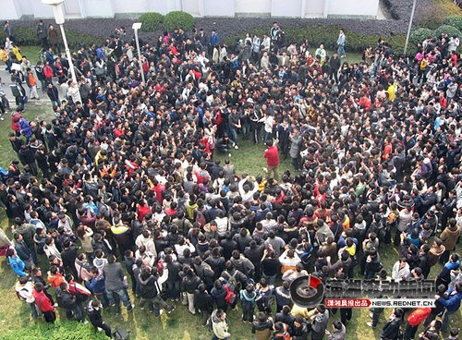
The Gaze (WeiGuan)

Slide 10
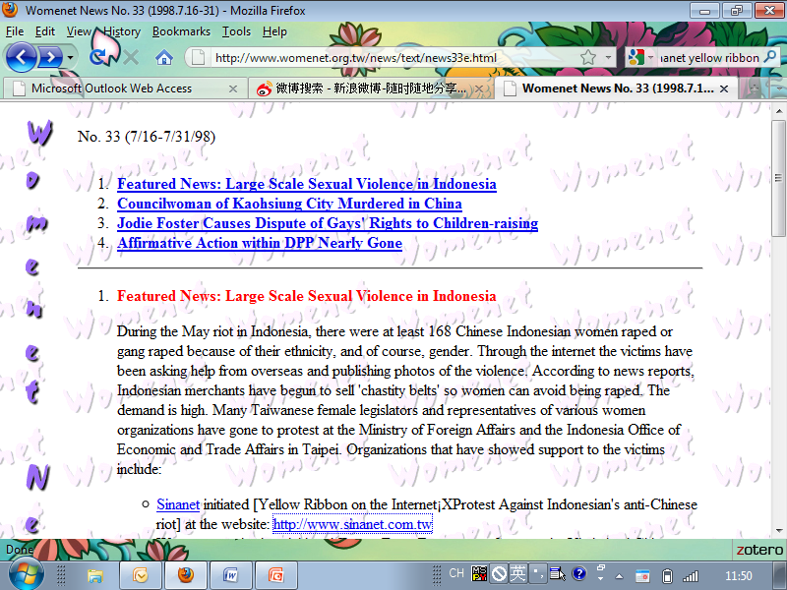

Yellow Ribbons

Slide 11
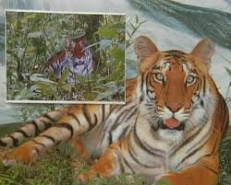
South China Tiger

Slide 12

Phoenix Trees in Nanjing

Slide 13
Summary of Cases
 | Yellow Ribbons | South China Tiger | Phoenix Trees
Key technology | Email, BBS | Blogs, BBS | Weibo
Motivation | Ethnic identity | Holding authority accountable; | Changing government behaviour; protecting the environment
Heterogeneity of actors and actants | Ethnic Chinese people around the world, SINANet, ICTs, yellow ribbons | Netizens, researchers and experts, legal professionals, the media, tiger photos, legal procedures, ICTs | Netizens, celebrities, Taiwanese politician, citizens in Nanjing, phoenix trees, green ribbons, ICTs
Geographical boundaries | Global | China | Nanjing, China and Taiwan

Slide 14
Analysis
Collective action as instantiations of collective agency
The cases are extensions of Internet activism described earlier, all are reflections of collective agency;
The importance of non-human actors;
Temporal emergence & rhizomatic contingency

Slide 15
Final words
Internet activism constitutes a form of collective agency that would not be possible without ICTs
Construction of virtual pubic sphere that is critical to a civil society
From sustainability to rhizomatic dynamism.

Slide 16
References
Bennett, W.L., 2003. New Media Power: The Internet and Global Activism. In Contesting Media Power. Rowman and Littlefield.
Deleuze, G. & Guattari, F., 1987. A Thousand Plateaus: Capitalism and Schizophrenia, University of Minnesota Press.
Jullien, F., 1995. The propensity of things: toward a history of efficacy in China, New York Cambridge Mass.: Zone Books; Distributed by MIT Press.
Latour, B., 1999. On Recalling ANT. In Actor Network Theory and After. Oxford: Blackwell Publishers / The Sociological Review, pp. 15-25.
Melucci, A., 1994. The Process of Collective Identity. In Social Movements and Culture. Minneapolis: University of Minnesota Press, pp. 41-63.
Rodríguez-Giralt, I., 2011. Social Movements as Actor-Networks: Prospects for a Symmetrical Approach to Doñana’s Environmentalist Protests. Convergencia. Revista de Ciencias Sociales, 18(56), pp.13-35.

